Slide 1




Graduation Project
GOLD INSIGHTS

Slide 2




TEAM
WORK
GANNA ELABSY
21-00716
AHMED SALEH
21-00350
MAZEN SAFTY
21-01055
TEAM LEADER
MOHAMED SAMIR
21-01232

Slide 3



MOHAMED SHERIF
21-01140
MINA FADY
21-01071
SUPERVISED BY
PROF DR. ALAA ZAKY
ENG. MARTINA GIRGIS
ABDELRAHMAN ABOSADA
21-00269

Slide 4


Abstract
The gold market is highly volatile, making it difficult for investors to predict price movements and make informed decisions.
This project aims to develop a deep learning-based system to forecast gold prices using historical price data and key economic indicators like inflation and interest rates.
In addition to price prediction, the system includes gold market analysis, educational resources, expert opinions, and the latest news to help users understand market trends and improve their investment knowledge.
By combining accurate forecasting models with insightful content, the project offers a reliable tool to support smart investment decisions in gold trading.

Slide 5


Outline
INTRODUCTION
PROBLEM STATEMENT
RELATED WORK
FEATURES
TOOLS AND THECNOLOGY
OBJECTIVES AND APPROACH
FUTURE WORKS
CONCLUSIONS
REFERENCES

Slide 6

Introduction

Slide 7


Introduction
Gold is a key asset in global financial markets, often used as a hedge against inflation and economic instability. However, its price is highly volatile due to factors like inflation, geopolitical events, and currency fluctuations.
Investors face growing challenges in predicting gold price movements accurately, especially with the increasing complexity of global economic conditions. Traditional analysis methods often fall short in capturing real-time dynamics.
This project aims to develop a smart and reliable system for forecasting gold prices using deep learning and economic indicators. It also includes expert insights, gold analysis, news, and educational content to help investors make informed decisions and reduce risk.

Slide 8
Problem Statement

Slide 9



Gold investors struggle to make informed decisions due to the high volatility of the gold market, which is influenced by multiple dynamic factors such as inflation, interest rates, and geopolitical events.
Problem
Statement
This project was developed to offer a smart forecasting and analysis system that helps users predict gold prices, understand market trends, and stay updated with expert opinions and real-time news.

Slide 10
Related Work

Slide 11


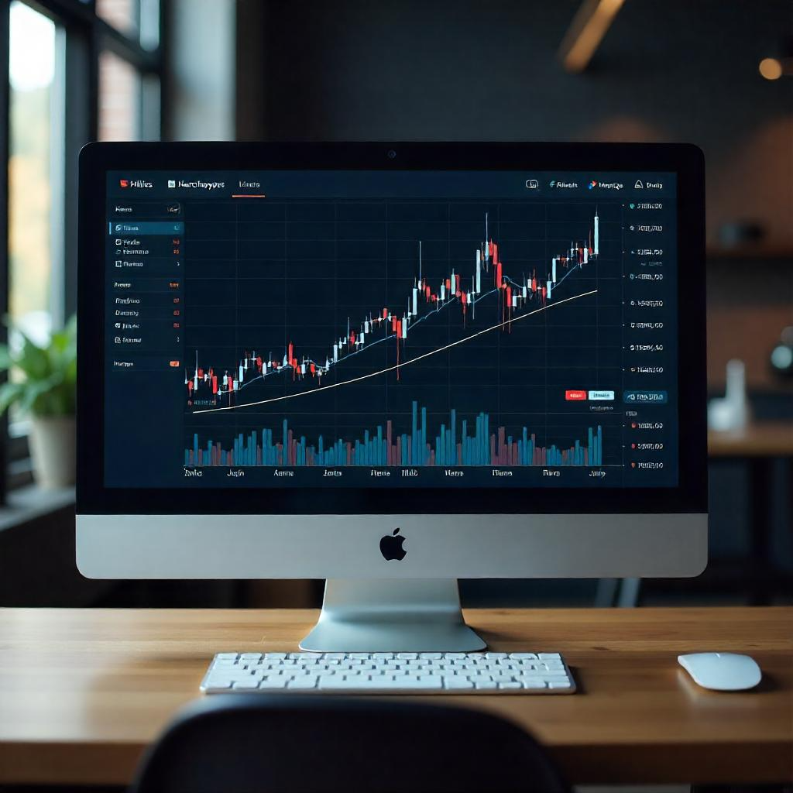
Related Work
One of the most popular platforms for market charting and analysis
It’s Features
technical charting tools
Real-time market data
Strong community sharing analysis and ideas

Slide 12

No AI or machine learning | Uses deep learning for gold price prediction
No educational content | Includes tutorials and market education
Lacks expert advisory section | Offers expert insights and analysis

Slide 13

Related Work
Gold Predictor
A site that offers gold trading signals based on proprietary methods.
It’s Features
Regular gold price signals
Basic market sentiment insights
User-friendly signal interface

Slide 14
No disclosure of AI/ML usage | Uses deep learning models
No educational materials | Includes full educational modules
Only signal-focused | Combines prediction, learning, and insight
Gold Predictor

Slide 15

Related Work
Premium-grade financial information platforms used by professionals
It’s Features
Real-time financial data and charts
In-depth analysis
Economic and financial news feed

Slide 16
High cost, not accessible | Free or low-cost for general users
Complex for beginners | Simple, user-friendly interface
No AI-driven gold prediction | Deep learning-based forecast engine

Slide 17
Features

Slide 18




Features
Real time news and current gold price
Deep Learning Forecasting
Gold Insights
Recommendations based on prediction
Education and Tools
Your guidance
Deep Analysis for gold and market
Gold Experts

Slide 19
Tools and Technology

Slide 20


Tools and
Technology
HTML + CSS
Front
End
React
Python
JavaScript
Deep Learning
AI
Web Scraping
Node JS
BackEnd
Mongo DB
Postman

Slide 21
OBJECTIVES AND APPROACH

Slide 22

Objectives
1- Build a deep learning model to predict future gold prices using historical data and economic indicators.
2- Provide buy, sell, or hold recommendations based on predicted price trends.
3- Analyze historical gold prices with economic factors and assess impacts of major external events.
4- Create an educational section covering gold market basics, influencing factors, and investment strategies.
5- Integrate APIs for real-time gold prices and market news updates.
6- Develop an easy-to-use website to display predictions, recommendations, and analysis for all users.

Slide 23


Approach
Web Scraping
Data
Preprocessing
AI
Data Analysis
LSTM Model

Slide 24

Web Scraping
Web scraping is the process of automatically collecting data from the internet. While it has been known by different names like screen scraping, data mining, and web harvesting, the term "web scraping" is now widely used. It involves using programs called web crawlers or bots to navigate through multiple web pages. In essence, web scraping enables us to gather data in ways other than interacting with APIs or using web browsers. By writing automated programs, we can query web servers, retrieve data (typically in HTML format), and extract the necessary information. Web scraping encompasses various programming techniques and technologies, including data analysis, natural language parsing, and information security.

Slide 25
Web Scraping Steps
1- Identify the target website: Choose Yahoo Finance as the source.
2- Analyse website structure: Understand how the information is organized.
3- Select data to scrape: Determine the specific information required.
4- Inspect HTML source: Use browser tools to examine the webpage source code.
5- Choose a scraping tool: Select a suitable library like BeautifulSoup.
6- Write the scraping script: Automate data extraction using Python.
7- Scrap table columns first and then the data
8- Clean and process data: Remove unwanted characters and handle missing values.
9- Store the scraped data: Choose a storage format like CSV.

Slide 26
Data Preprocessing
1- Load scraped data: Import all scraped tables into separate DataFrames.
2- Clean numeric and date fields: Remove commas from numbers and convert them to floats and date to datetime.
3- Unify time frequency: Resample or reindex all datasets to the same frequency (daily).
4- Handle missing values: Fill or drop missing entries using methods like fillna() or dropna().
5- Standardize column names: Rename columns to be clear and consistent across all datasets.
6- Merge datasets: Combine all cleaned DataFrames into one master DataFrame.
7- Export cleaned data: Save the final processed DataFrame to CSV or another suitable format.

Slide 27
Data Analysis
1- Load preprocessed data: Import the cleaned and merged DataFrame containing gold prices and related features.
2- Explore data relationships: Analyze correlations between gold and other influencing factors (e.g., oil, dollar, inflation).
3- Visualize trends: Use Matplotlib and Seaborn to plot time series, distributions, and correlation heatmaps.
4- Detect external events: Highlight the impact of major economic or political events on gold price fluctuations.
5- Summarize key insights: Identify patterns, anomalies, and significant relationships that affect gold price movements.
6- Build analysis page: Integrate visualizations and insights into the analysis page of the user platform for interactive exploration.

Slide 28
LSTM Model
1- First, we loaded the cleaned and preprocessed dataset. Then, we applied MinMaxScaler to normalize all input features to a range between 0 and 1.
2- Next, we defined a validation strategy suitable for time-series forecasting by using TimeSeriesSplit with 5 folds to maintain chronological order during training and evaluation.
3- After that, we built an LSTM model using Keras, consisting of stacked LSTM layers with dropout and dense layers to capture temporal dependencies in the data.
4- Then, we trained the model on each fold using early stopping and learning rate reduction callbacks to prevent overfitting and stabilize the training process.
5- Finally, we evaluated the model on the test set, achieving high performance.

Slide 29
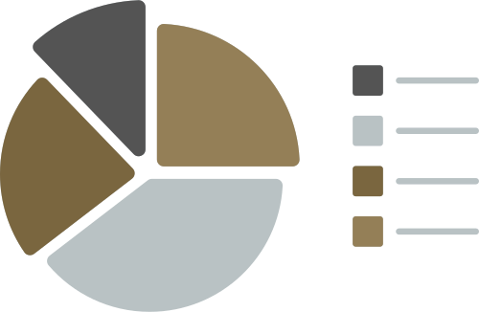
LSTM Model
1.42%
MAPE
40.67
R² Score
29.12
MAE
RMSE
97.01%

Slide 30
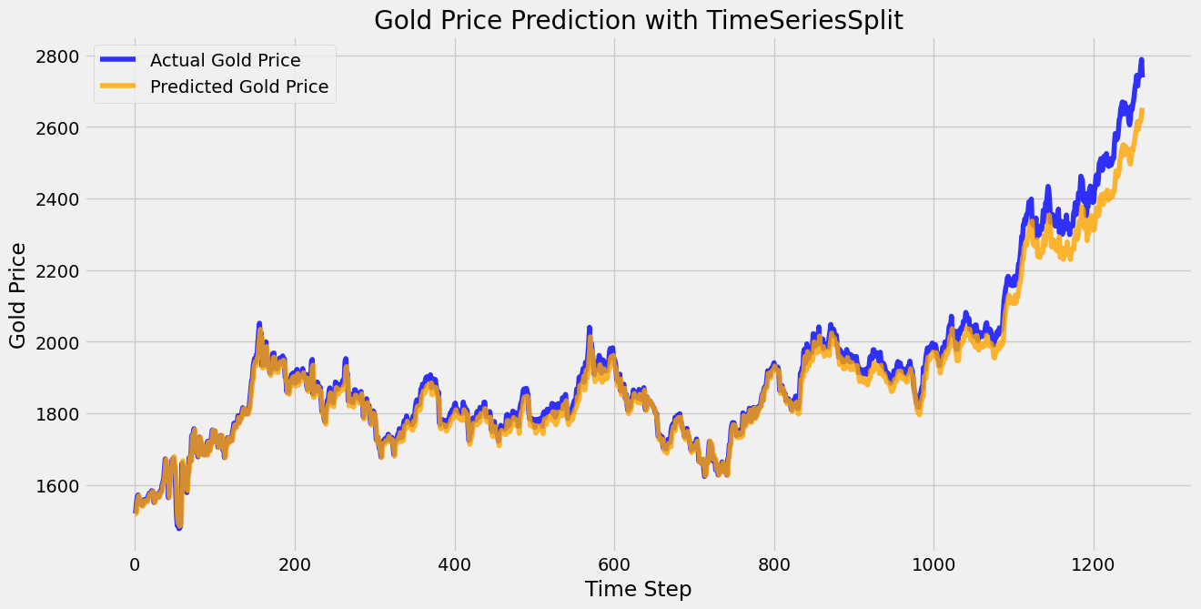
Evaluation Chart

Slide 31
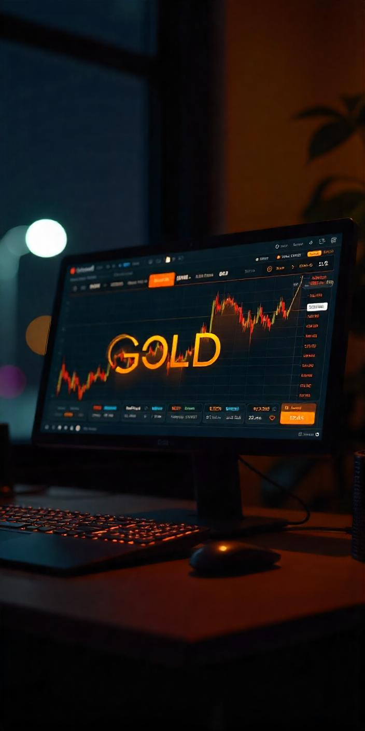
Approach
HTML
CSS
Front
End
JavaScript
REACT

Slide 32
Front End
1- We developed a fully functional and responsive website using HTML, CSS, JavaScript, and the React.js framework.
2- The UI was designed with a clean and modern layout, focusing on ease of use, clarity, and performance across devices.
3- We utilized interactive charting libraries such as:
Recharts for data visualization (line charts, bar charts, tooltips, etc.)
PapaParse for parsing CSV data files.
date-fns for efficient date formatting and manipulation.
4- The platform includes:
Interactive charts to explore seasonality trends and price history.
Dynamic components connected to backend data and APIs.
Data filtering, tooltips, and formatted insights for enhanced user experience.
5- This front-end enables users to visually understand gold market behavior, interact with data, and explore detailed analyses through intuitive dashboards.

Slide 33
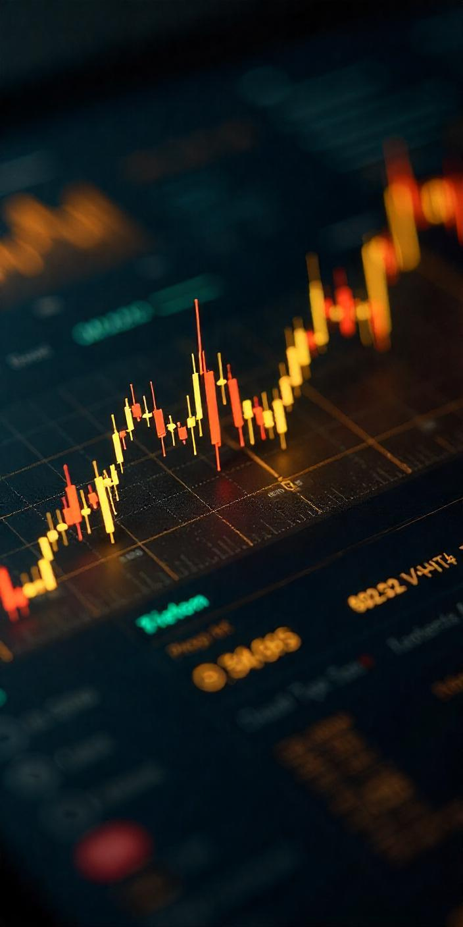
Approach
Node JS
Mongo DB
Back
End
Postman
APIS

Slide 34
Back End
1- Developed the back-end using Node.js for handling server logic efficiently.
2- Used MongoDB to store user data and application information securely.
3- Implemented APIs that fetch features for the prediction model and send the results to the front-end for display.
4- Connected the back-end with the prediction model running on Flask, enabling seamless communication between Node.js and Flask services.
5- Managed user authentication with secure login and registration processes, fully integrated with the front-end interface.
6- Utilized Postman for API testing and validation to ensure robustness and reliability.
7- Established connection between back-end and front-end using ngrok to expose local server endpoints securely for development and testing.

Slide 35
Future Work

Slide 36


Future Work
1- We will expand the platform to support other assets like platinum, and cryptocurrencies for broader market coverage.
2- We will develop a smarter recommendation system that considers user profiles, risk levels, and behavior for personalized insights.
3- We will create a mobile application to allow users to receive notifications, view prices, and access forecasts anytime, anywhere.
4- We will add interactive community features such as feedback, prediction ratings, and discussion forums to enhance user engagement.

Slide 37
Conclusion

Slide 38

Conclusion
Successfully developed a comprehensive platform for gold price prediction and market analysis.
Built a user-friendly front-end with React, featuring interactive visualizations for deeper insights.
Implemented a robust back-end with Node.js and MongoDB, integrating secure user authentication and real-time API communication.
Connected the back-end with a powerful LSTM prediction model running on Flask for accurate forecasting.
Leveraged modern tools and libraries to ensure scalability, reliability, and a smooth user experience.
The platform provides valuable features to support informed investment decisions and market understanding.

Slide 39
References

Slide 40
References
Bloomberg: https://www.bloomberg.com
Gold Predictor: https://goldpredictor.com
TradingView: https://www.tradingview.com
FRED API (Federal Reserve Economic Data): https://fred.stlouisfed.org/docs/api/fred/
Yahoo Finance: https://finance.yahoo.com

Slide 41


Thank You

